Slide 1

RCB - IPL Data Analysis
SQL Project
Name : Shweta Teli
Submission Date : 31/7/2025

Slide 2

Agenda
Introduction
Problem Statement
Database Schema & Data Overview
Objective Key Metrics and Visualizations
Subjective Question for Insights
Recommendations

Slide 3
About Franchise
Royal Challengers Bengaluru, a professional cricket franchise that competes in the Indian Premier League (IPL) representing Bengaluru, a city from Karnataka in India .
Royal Challengers Bengaluru is part of IPL from inaugural Year i.e. 2008.
RCB hold the record for Highest Partnership in IPL between two batsmen.
RCB holds the record for hitting the most sixes by a team in a single IPL season.
RCB commands one of the most passionate fan bases in IPL history.

Slide 4
Business problem statement
Despite featuring star players and thrilling performances, RCB has never clinched an IPL title. Their campaigns have been marked by:
Inconsistent team combinations
Weak death bowling & pressure handling
Over-reliance on a few key players
🔍 Objective:
This project aims to uncover data-driven insights to answer:
What’s holding RCB back?
Who are the consistent and impactful players?
How can RCB optimize their auction strategy and select the best-performing players to build a title-winning team?

Slide 5
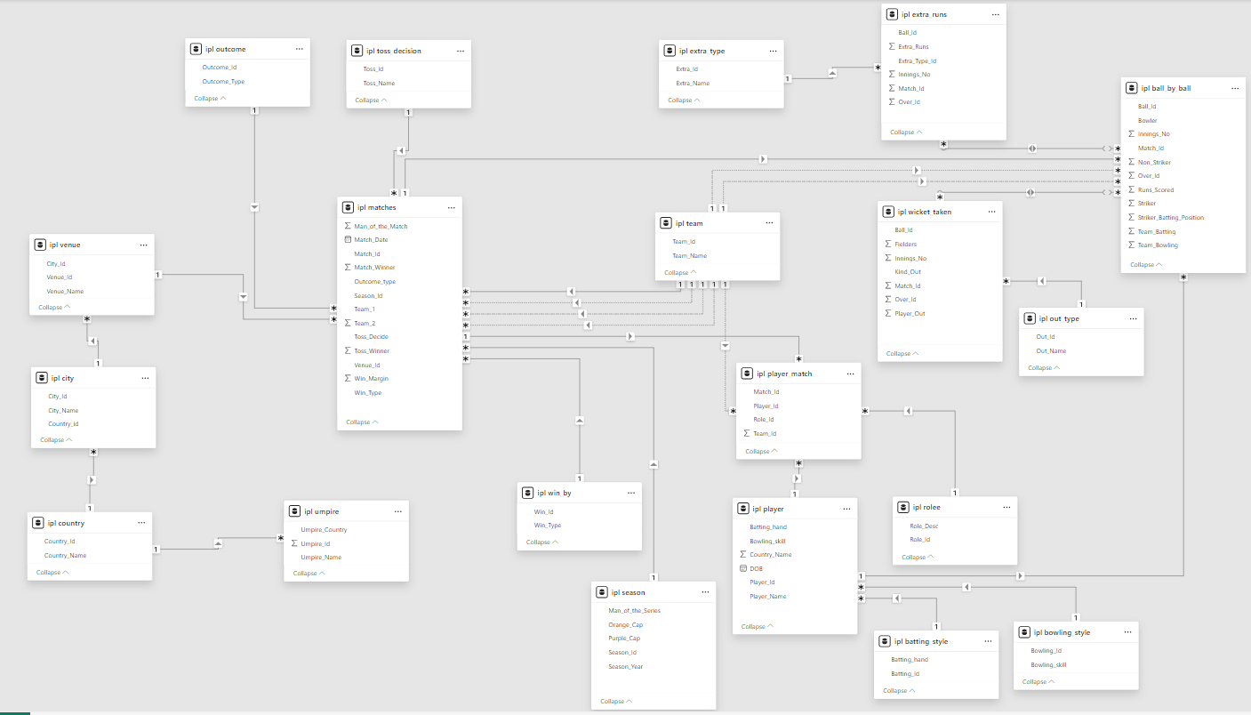
Database Schema

Slide 6
Data Overview
Source: IPL relational database (MySQL-based)
Seasons Covered: Multiple IPL seasons (2008 onwards)
Volume:
15,000+ ball-by-ball records, 700+ matches, 300+ players, 20+ venues
Table Name Description
Matches Match-level details (teams, venue, result)
ball_by_ball Every delivery’s run, player, and outcome
player Player details (ID, name, type)
wicket_taken Records of dismissals
season Season year & ID
venue Stadium info
team Team ID and name mapping
toss_decision Toss decision lookup
player_match Player participation in matches

Slide 7
Objective & Subjectives of the Analysis
Main Goal:
To assist RCB in forming a balanced, winning squad and build strategies based on performance insights.
Key Objectives:
Identify consistent players across seasons
Understand toss and venue impact
Highlight top batsmen, bowlers, and all-rounders
Evaluate RCB's past performance trends
Build auction strategy for future seasons

Slide 8
Consistent Player Performance
Insight: Players like Virat Kohli, AB de Villiers, and Chris Gayle showed high and steady averages over multiple seasons, proving their reliability.
Recommendation: ✔ Retain or scout players with consistent season-wise averages to build a solid batting core.

Slide 9
Venue-Specific Batting
Insight: Some batsmen consistently score higher at specific venues (e.g., flat pitches like Chinnaswamy Stadium favor high scoring).
Recommendation: ✔ Use this data to optimize player selection for venue-based match planning. ✔ Retain players who perform well at home grounds.

Slide 10
Toss Strategy Impact by Venue
Insight: Winning the toss and choosing to chase provides better win ratios at certain venues, while batting first is better elsewhere.
Recommendation: ✔ Plan toss decisions based on venue conditions and historical outcomes.

Slide 11
Toss Decision Efficiency
Insight: Teams that win the toss and make the right decision (bat or bowl) enjoy a higher win percentage (~55–60%).
Recommendation: ✔ Develop a data-driven toss strategy to gain early match advantage.

Slide 12
Versatile Player Performance
Insight: All-rounders with 200+ runs and 10+ wickets provide flexibility and balance.
Recommendation: ✔ Target players with dual capabilities in the auction for tactical advantage and depth.

Slide 13
Match Winners
Insight: Players with high Man of the Match counts are game-changers under pressure.
Recommendation: ✔ Prioritize retaining or bidding for players who have a history of match-winning performances.

Slide 14
Average Team Score per Venue in IPL
Insights
Chinnaswamy & Wankhede are top high-scoring venues (Avg > 180).
Flat pitches & short boundaries favor batsmen.
High totals are common, especially in evening games.
Recommendations
Build batting-heavy squads for these venues.
Pick bowlers with strong death-over skills.
Use high-scoring games for fan engagement & branding.

Slide 15
RCB Overall Season Performance
Insight: RCB shows inconsistent win-loss patterns across seasons with playoff exits and few finals.
Recommendation: ✔ Focus on strengthening weak areas (especially bowling) and improving performance in crucial matches.

Slide 16
RCB Bowling Weakness
Insight: RCB concedes high runs per match, especially in smaller venues like their home ground.
Recommendation: ✔ Recruit death-over specialists and economical bowlers to contain runs in powerplay and slog overs.

Slide 17
Summary
This project analyzed IPL historical data using SQL and Excel visualizations, focusing on Royal Challengers Bangalore (RCB).
The objective was to evaluate team consistency, player performance, auction strategy, and factors influencing match outcomes.
Data from multiple seasons was explored to assess toss impact, venue influence, all-round capabilities, and RCB’s match trends.
Key visualizations included player performance by season/venue, toss decision analysis, and bowling inefficiencies.

Slide 18
Conclusion
Despite having top-tier players, RCB has struggled with inconsistency, especially in bowling depth and pressure games.
Toss decisions and venue conditions significantly influence match outcomes, often overlooked in team strategy.
A few consistent performers have been the backbone of the team, but overreliance has hurt RCB in critical moments.
All-rounders and match-winners (high "Man of the Match" players) provide strategic flexibility and should be prioritized.
RCB’s inability to contain runs highlights a persistent bowling issue, particularly at smaller, batting-friendly venues like Chinnaswamy.

Slide 19
Final Recommendations for RCB
Auction Strategy
✅ Retain consistent top-order batsmen with 3+ good seasons.
✅ Target bowlers with strong strike rates and control in death overs.
✅ Invest in quality all-rounders who can adapt to various roles.
Venue-Based Strategy
✅ Use venue-specific data to plan toss decisions and team combinations.
✅ Recruit bowlers who can perform at high-scoring venues.
Tactical Suggestions
✅ Build bench strength to avoid over-reliance on 2–3 players.
✅ Consider players with proven “match-winning” records under pressure.
Data-Driven Culture
✅ Incorporate performance dashboards into coaching and selection.
✅ Use past performance and conditions data to build match-day strategies.

Slide 20
Thank you

